Slide 1
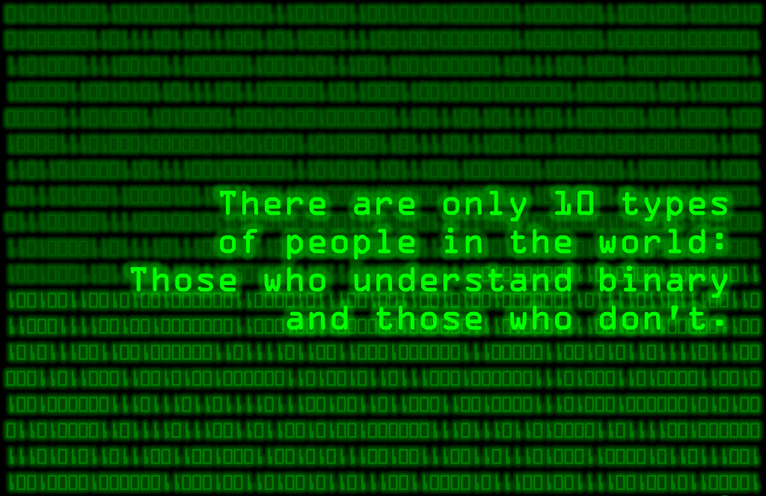

Biomedical Informatics
@ emory.edu
BMI 500

Slide 2
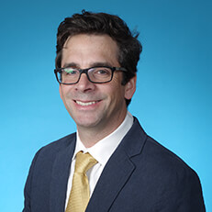
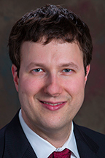
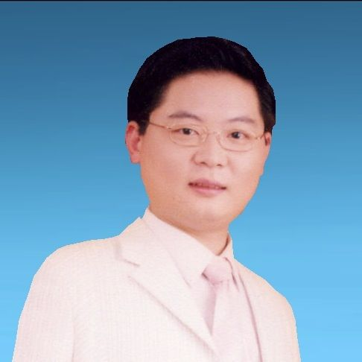
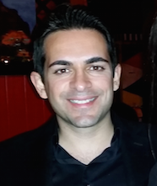
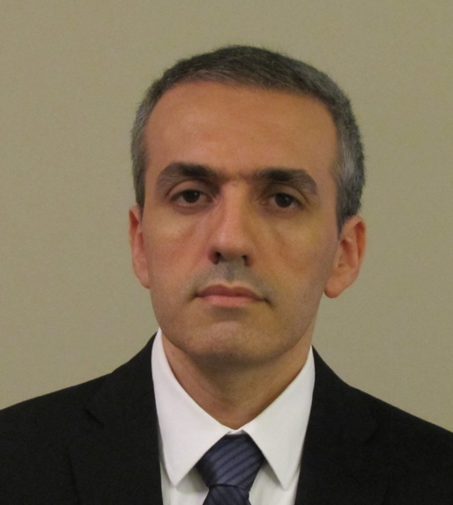
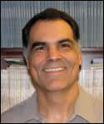
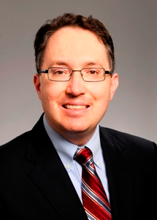
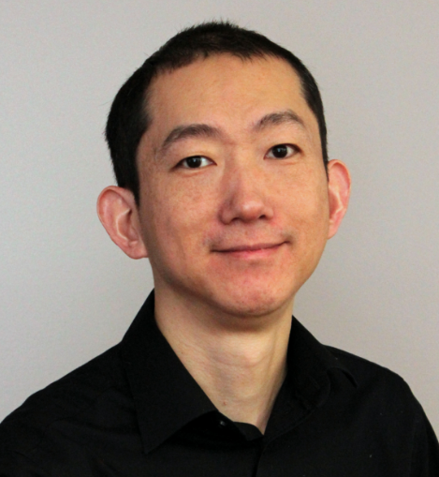
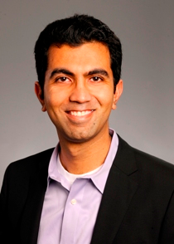
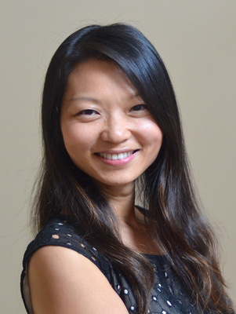
Who is BMI? 23 faculty, 11 for BMI 500
Gari Clifford
Interim Chair
Assoc. Prof.
(BMI/BME)
Jim Blum
Vice-Chair for
Clinical Research,
Chief, Critical Care,
Ass. Prof. Anesthesiology
Lee Cooper
Assistant Prof.
(BMI/BME)
Jun Kong
Assistant Prof.
Shamim Nemati
Assistant Prof.
Babak Mahmoudi
Assistant Prof.
Carlos Moreno
Associate Prof.
Pathology & BMI
Zhaohui (Steve) Qin
Associate Prof.
(Biostats & BMI)
Andrew Post
Associate Prof.
BMI/ACTSI
Ashish Sharma
Assistant Prof. /
Co DGS
Li Xiong
Associate Prof.
Notes:
Ashish, Jun, Lee, Shamim, Babak, Gari,
Jim Blum, Le Xiong, Steve Chen/Carlos Moreno
Only 6 today!

Slide 3






BSc. Physics & Electronics (Exon)
MSc. Math & Theoretical Physics (Soton)
DPhil in AI / Sig Proc (Oxon)
Postdoc HST (MIT)
Principal Research Scientist (MIT)
Associate Prof BME (Oxford)
Directory, Center for Doctoral Training, BME (Oxford)
Associate Prof Emory (BMI) / GTech (BME)
Interim Chair BMI
Honorary Professor, Univesrity of Oxford
Adjunct Prof., Morehouse School of Medicine
Distinguished Guest Prof., Tsinghua Univesrity
Deputy Editor, Journal of Physiological Measurement, Institure of Physics.
Gari Clifford
http://gdclifford.info

Slide 4
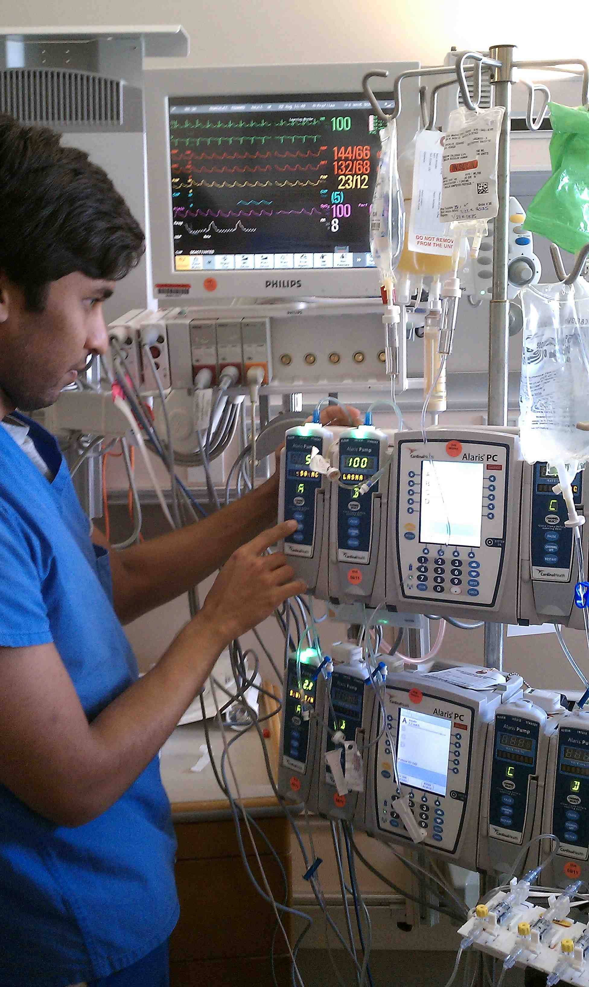
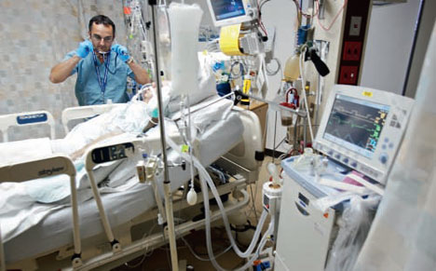
Big Data (Streaming) Healthcare – Sig. Proc. & Machine Learning
Currently at Emory’s ICUs:
Volume – 24TB over the last two years
Velocity – 1 GB/person/day
Variety – Up to 10,000 parameters electrophysiology, images, free text, microbiology, interventions, ICD9
Veracity – up to 90% of alarms are false!
Intelligent
SIGNAL PROCESSING
Eliminating maternal information from the abdominal recording to accurately identifying fetal heart rate.
Unambiguous
INFORMATION OUTPUT
G. D. Clifford

Slide 5
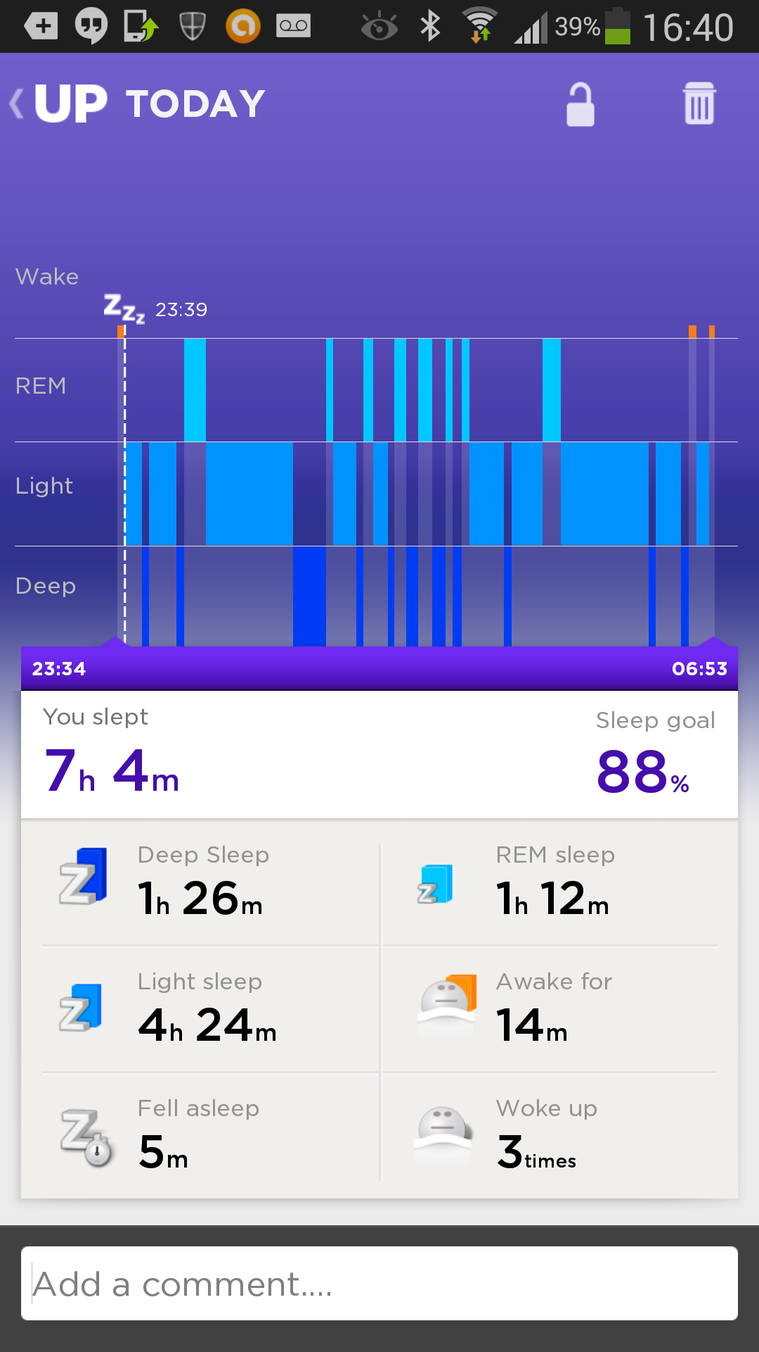
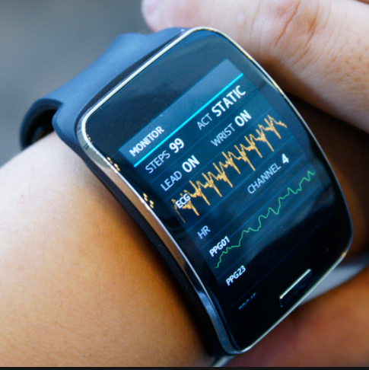
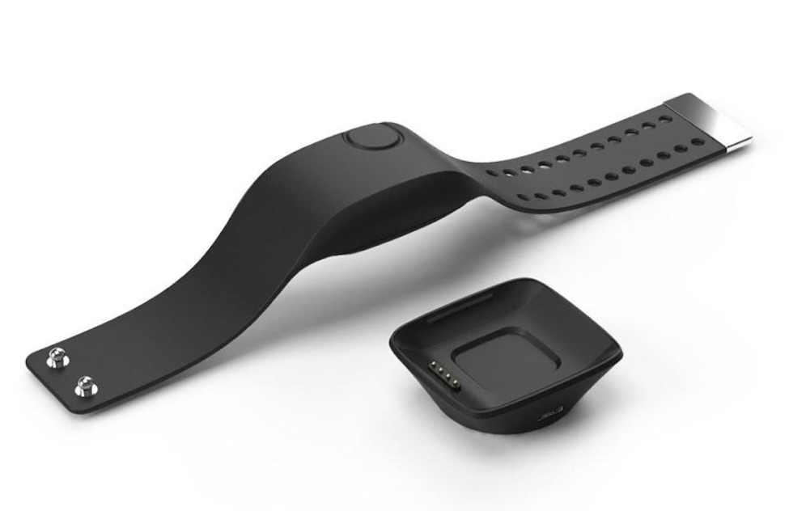
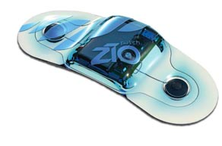
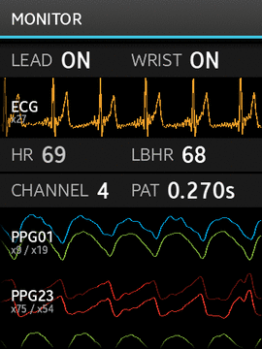
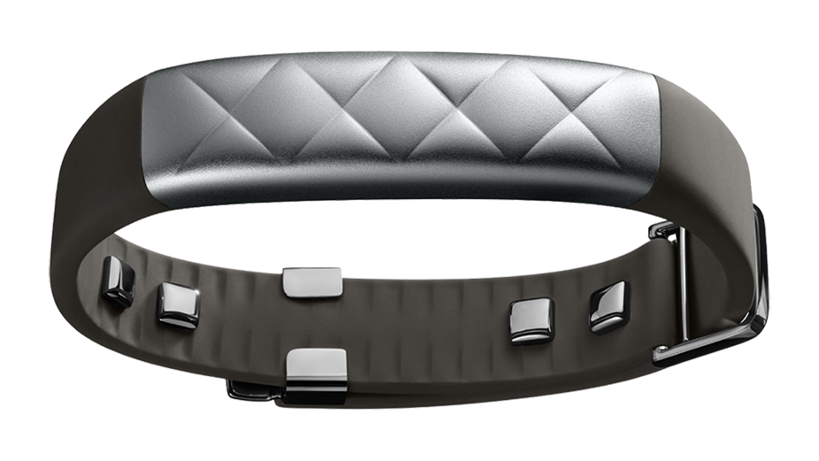
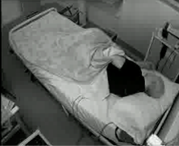
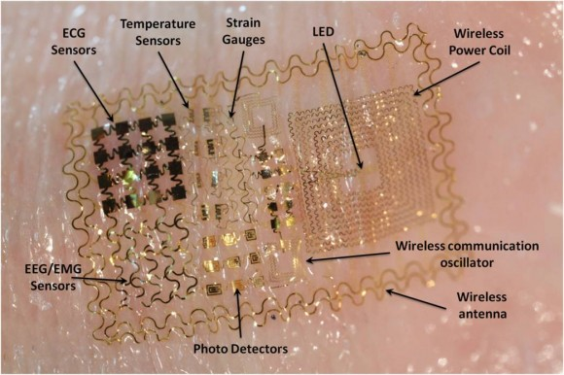
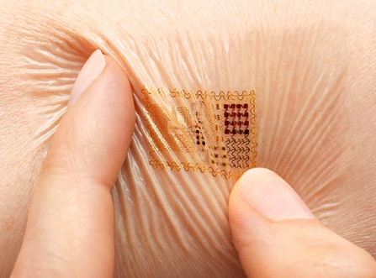
Sleep, Circadian Rhythms
Neuroscience & Behaviors
EEG & ECG analysis
O2, Respiration, Movement
Phone Apps
Wearables
Actigraphy analysis
Physiology-based
Video
Voice analytics
Unambiguous
INFORMATION OUTPUT

Slide 6
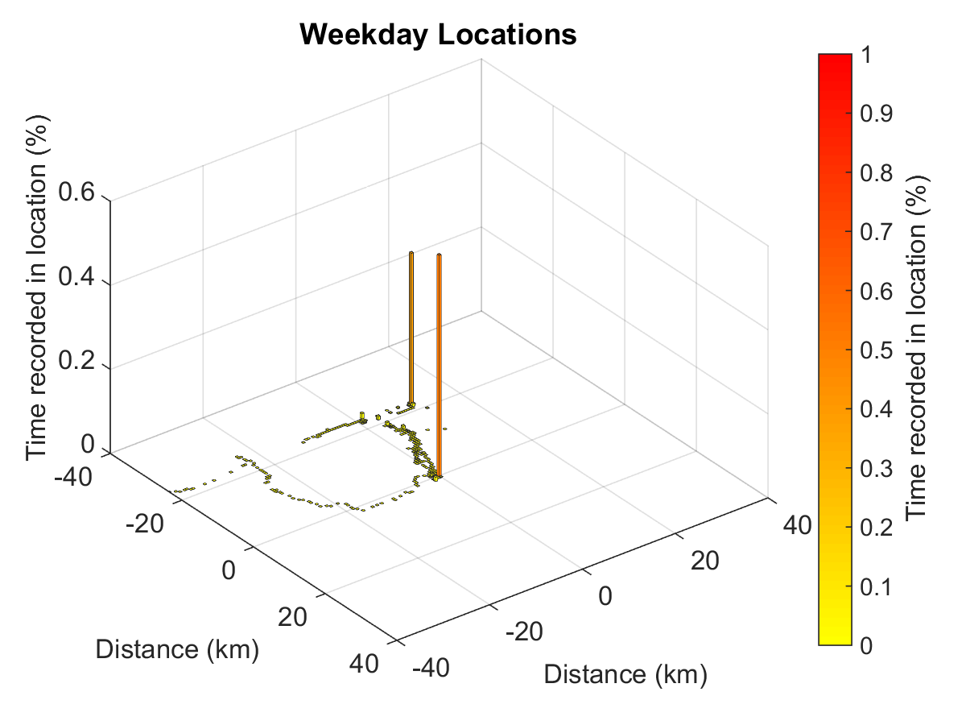
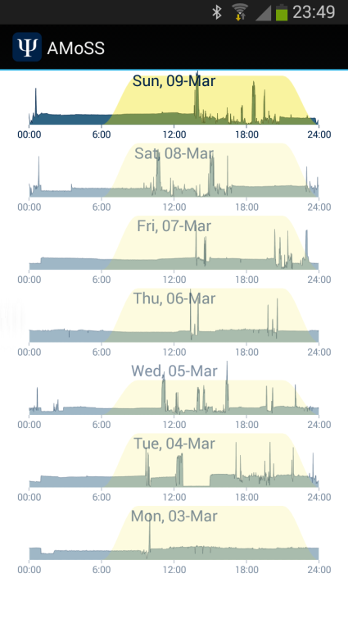
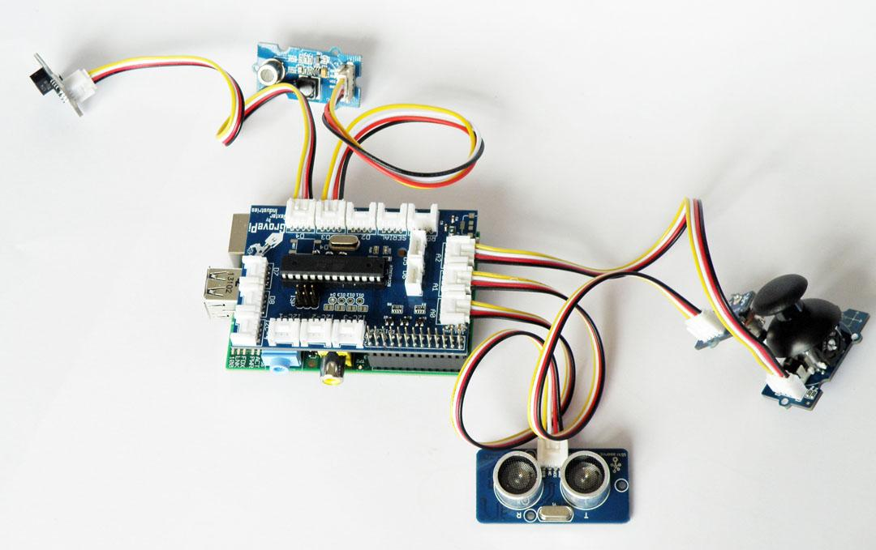
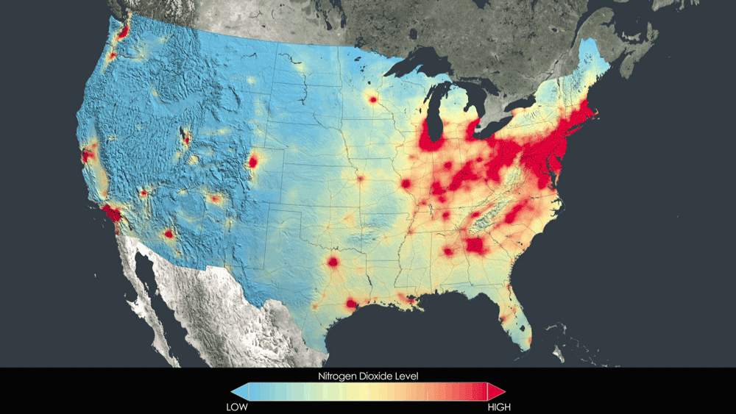
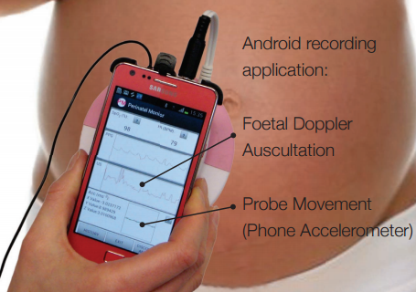
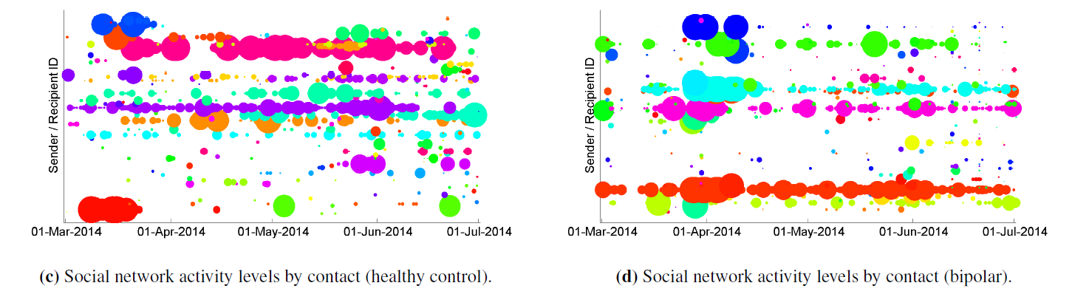
Projects: ML & Sig. Proc. for …
Sleep / mental health Computational Psych. (Depression, Schizophrenia, PTSD)
Biopyschosocial effects on CVD / PTSD
Healthy Aging Study (Alzheimer's)
Seizure detection (Rhett)
CHF readmissions using wearables
AF & Stroke Prediction
Environmental factors @Exposome Center
Context Aware Electronic Medical Records
Video: Sedation and Agitation in the ICU
Voice analytics (neurodegeneration)
Eye tracking (vigilance, accuracy, disease progression)
Perinatal: IUGR, fetal stressors, preconception, intrapartum monitoring, growth, maternal health

Slide 7
Lee Cooper
PhD in Electrical Engineering - Signal Processing & Control (Ohio State)
Assistant Professor of Biomedical Informatics (Emory)
Assistant Professor of Biomedical Engineering (GT)
Core Member, Cancer Genetics & Epigenetics Program,
Winship Cancer Institute
Faculty, Cancer Biology Program (Emory)

Slide 8
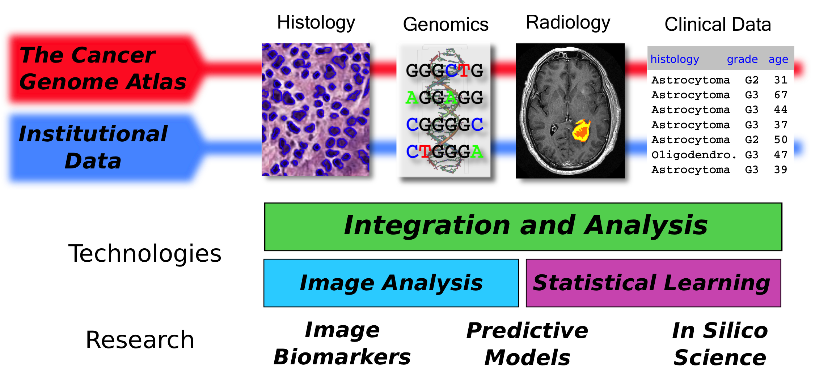
Transforming Cancer Data to Knowledge & Practice
How can data + algorithms:
-Improve prediction of clinical outcomes and patient care? (translation)
-Provide understanding of fundamental biological processes? (science)
TCGA Research Network, Comprehensive, Integrative Genomic Analysis of Diffuse Lower-Grade Gliomas.
N Engl J Med. 2015 Jun 25;372(26):2481-98
L.A.D. Cooper

Slide 9

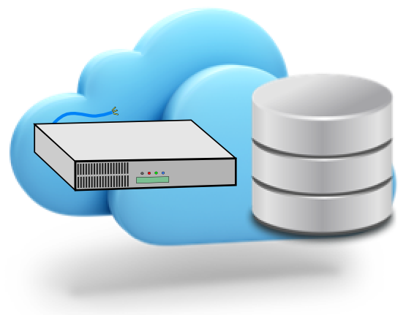
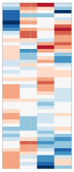
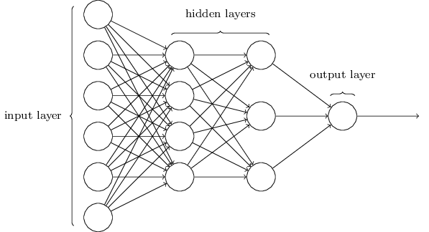
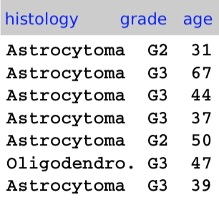
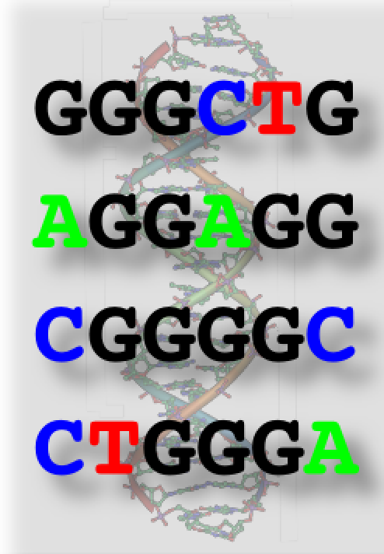
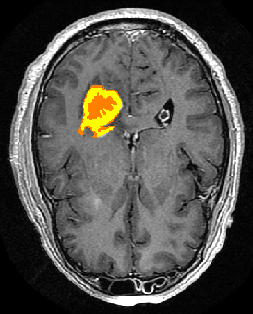
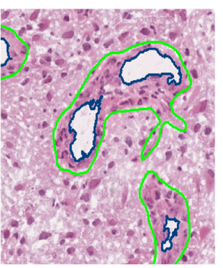
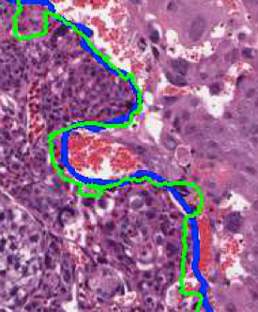
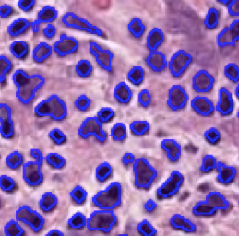
Predicting Outcomes from High-Dimensional Genomics
Prognostic Models Based on Deep Neural Networks & Bayesian Optimization
Data + Algorithms
Features
Clinical, Genomic and Radiology Data
Genomics
(10,000+)
Radiology
(100M+)
Clinical (100+)
Survival Predictions
Clinical Decision Support
Surgery?
Radiation?
Pathology Data + Algorithms
Chemotherapy?
Combination?
L.A.D. Cooper

Slide 10
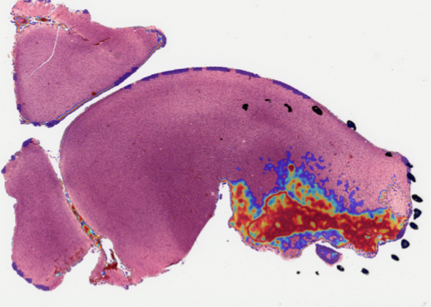

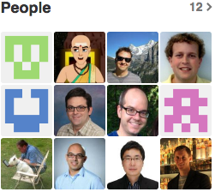
HistomicsTK: Algorithms and Infrastructure for Pathology Image Analysis
Image-Analysis Algorithms
Containerize and model metadata
50K x 80K pix
Workflows, Execution, Database
for Terabytes of pathology
data and metadata
https://github.com/DigitalSlideArchive/HistomicsTK
20,0000 lines of code, 900 commits and growing
L.A.D. Cooper

Slide 11




Jun Kong
Information and Control Engineering
(Shanghai Jiao Tong University)
Electrical Engineering
(Shanghai Jiao Tong University)
Electrical & Computer Engineering
(Ohio State University)
Research Scientist and Sr. Research Scientist
(Emory)
Assistant Professor
(Emory)
Member of Winship Cancer Institute
(Emory)

Slide 12
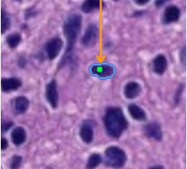
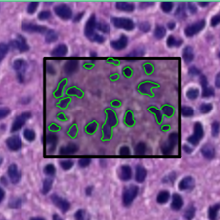
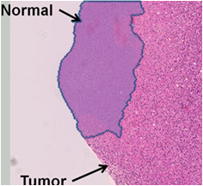
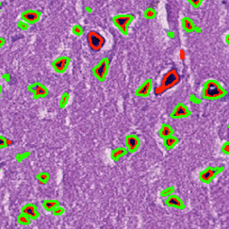
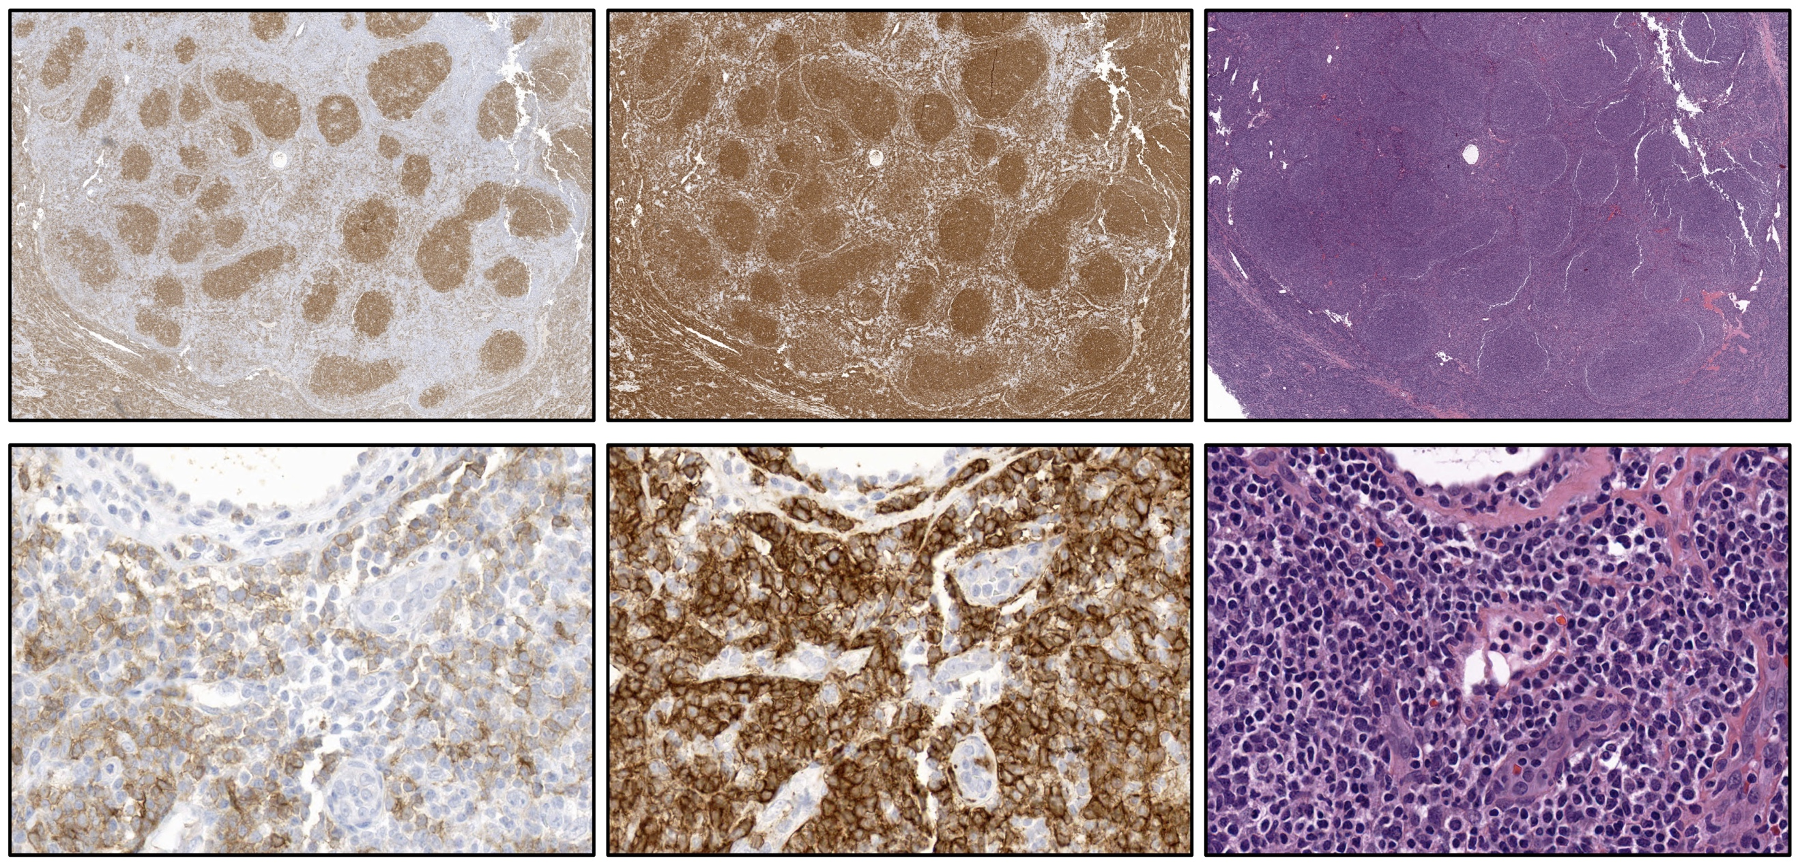
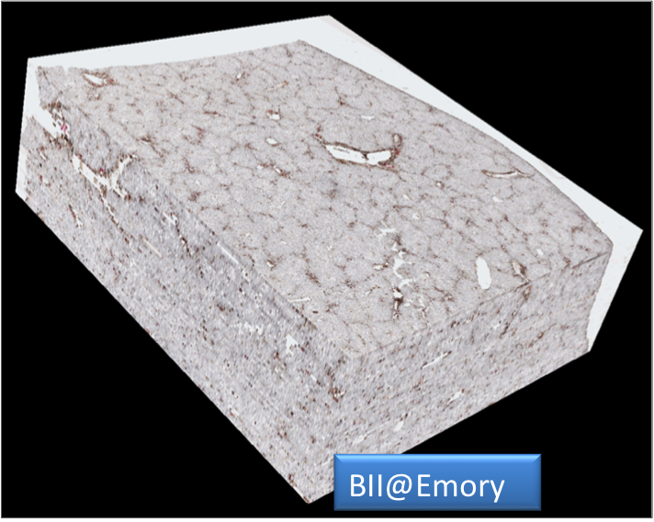
Big Histopathology Imaging Data
– Currently @Emory Pathology
Volume –TB over the last few years
Velocity – 100 GB/day
Variety – Bright field (H&E, IHC), Fluorescence,
Confocal Imaging, Multiphoton, Electron Microscope
Pathology structures – cells, vessels, etc.

Slide 13
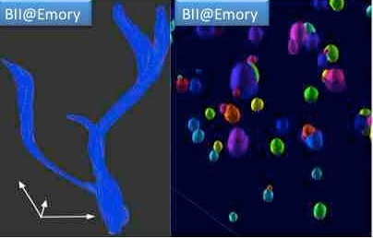
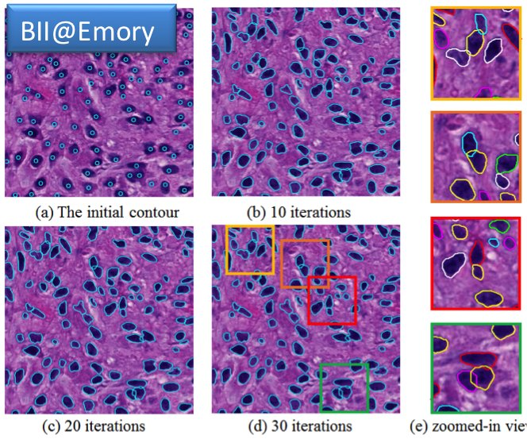
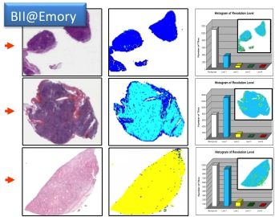
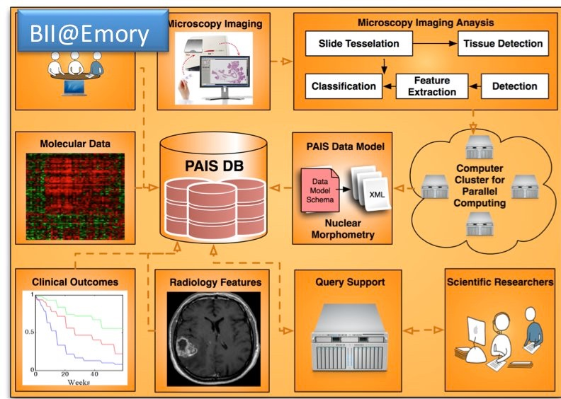

Slide 14



Projects
Live cell tracking with 3-D fluorescent microscopy images
2-D and 3-D pathology image analysis
Histology and biomarker imaging integration
Video analysis for pollinator tracking analysis
Image analysis and machine learning for Computer-aided diagnosis
3-D pathology spatial analytics
Deep learning classification with radiology image volumes
Deep learning classification with 2-D and 3-D pathology images
Geometric object representation

Slide 15

Babak Mahmoudi, PhD
BSc in Electrical Engineering (University of Tehran)
MSc in Machine learning and Biomedical Signal Processing (Iran University of Science & Technology)
MSc & PhD in Neural Engineering, Machine Learning and Artificial Intelligence (University of Florida)
Postdoctoral fellowship in Translational Neural Engineering (Emory University & Georgia Tech)
Clinical Research Scientist in Deep Brain Stimulation modelling (Emory University)
Assistant Professor of Biomedical Informatics

Slide 16


Neuroinformatics & Designing Intelligent Systems
Neural Data Science
Intelligent neural interface systems
Simulation and modelling the neural networks

Slide 17






Experimental implementation and translational research
Closed-loop distributed microstimulation
Optogenetic neuromodulation
Clinical applications
Neuromodulation therapies for epilepsy and memory enhancement
Alzheimer’s disease

Slide 18
Projects
Developing machine learning and artificial intelligence algorithms
Decoding neural data for the identification of biomarkers
Optimization of neuromodulation therapies
Mathematical modelling the neural dynamics
Biologically realistic models of neural circuits
Black-box modelling the input-output relationship between stimulation and neural response
Implementation of the algorithms in experimental/clinical setting
Cloud-based computation
Mobile computing and developing apps
Real-time computation for closed-loop interaction with the brain

Slide 19
Shamim Nemati
PhD in Electrical Engineering & Computer Science (MIT)
Postdoc in Machine Learning (Harvard)
Assistant Professor (Emory BMI department)
Adjunct Faculty (Emory CS department)
Program Faculty (Emory CSI program)
shamim.nemati@emory.edu
BMI Department Room#579
http://nematilab.info

Slide 20

Machine Learning for Physiological Time Series
Intensive Care Unit (ICU) Analytics
Prediction of Impeding Adverse Events (e.g., Sepsis)
Time series Prediction/Classification
Model-based Machine Learning (ML)
Incorporating physiological models within ML algorithms
Nemati et al., J Appl Physiol, 2011, Nemati et al., IEEE EMBS, 2012
Notes:
Partial thromboplastin time
Andrew Michael

Slide 21



Deep Learning for Time Series Prediction & Classification
Intensive Care Unit (ICU) Analytics
Prediction of Impeding Adverse Events (e.g., Sepsis)
Time series Prediction/Classification
Model-based Machine Learning (ML)
Incorporating physiological models within ML algorithms
Professors Clifford
Professors Buchman
Streaming Analytics
Physiological Models
Deep Learning for Time Series
Finding Predictive Patterns in multivariate time series
Nemati et al., NIPS, Deep Learning, Montreal, Dec. 2014
Notes:
Model-based time series prediction/classification
Hidden state estimation

Slide 22


Precision Medicine: Sequential Decision Making
Nemati, Ghassemi, Clifford et al., EMBC , 2016 – in preparation
Figure 1. Sequential Decision Making for Medication Dosing in the ICU
Figure 2. Q-network for sequential decision making.
(a)
(b)
Figure 3. An examples of Heparin dosing (panel a), and population-level performance of the RL agent (panel b).
Notes:
Partial thromboplastin time

Slide 23

Computational Psychiatry
Finding objective metrics of patient improvement
Video Analysis (dynamical systems, multiscale entropy)
Physiological markers of stress & physical health
Wearable technology (smart-watches and patches)
Nemati et al, EMBC 2016
Audio and Text Analysis
Professors Helen Mayberg
Sahar Harati et al., EMBC 2016
Professors Clifford
Notes:
Radiology Reports, Discharge Summaries, and Nursing Notes

Slide 24






Sentiment Analysis on Clinical Text
Dr. Ghassemi
Dr. Falgun Chokshi
Figure 1. Schematic diagram of the proposed sentiment analysis technique
Figure 3. Clustering of patient data in the word2vec vector-space.
Figure 2. Schematic diagram of the proposed sentiment analysis technique
Figure 4. The sentiment score of the notes, partitioned by outcome class, and hospital stay day.
Ghassemi, Nemati, CinC (2015)
Notes:
Radiology Reports, Discharge Summaries, and Nursing Notes

Slide 25

Andrew Post
MD (Univ. of Pennsylvania)
PhD in Biomedical Informatics (Pitt)
Associate Professor (Emory)
Director, Biomedical Informatics Program, Atlanta Clinical and Translational Science Institute
Clinical Informatics Architect (Emory Healthcare)

Slide 26





Biomedical Informatics Program

Slide 27

Emory i2b2 – Cohort Discovery
SMART on FHIR
“I Want to Recruit Patients with Rheumatoid Arthritis…”

Slide 28

Eureka! EHR Phenotyping
“I Want to Create a Predictive Model of Hospital Readmissions…”

Slide 29
Ashish Sharma
Electrical Engineering (PEC, India)
PhD Scientific Visualization and Data Mining (University of Southern California)
Postdoc Biomedical Informatics (Ohio State)
Research Scientist (Ohio State)
Assistant Professor (Emory)
Ashish Sharma (ashish.sharma@emory.edu)
Psychology Building — #573
http://sharmalab.info

Slide 30



Research Data: everywhere & every which way
Large, Diverse, Heterogeneous, Noisy
Explore this data
Integrate (with other datasets)
Analyze (increasingly on the cloud)
Visualize
cancergenome.nih.gov/

Slide 31
Data Integration and Cloud-Based Analysis
Data Café — Dynamic data warehousing that allows one to connect disparate datasets. Highly scalable. Adding some intelligence.
Cloud-Pipe — Cloud based analysis and workflows. Designed for quantitative imaging. Ease of use.
Bindaas — Middleware system developed in our lab for easy development of secure and robust web-services.
End-User: Quantitative Imaging for Cancer Research

Slide 32
Data Exploration and Visualization
DataScope — Visual exploration of integrated datasets. Interactive; Fuse multiple sources – scientific mashups; Geo-spatial data support; Scalabale;
caMicroscope — Platform for visualizing, exploring and analyzing digital pathology data.
End-User: Co-Clinical Trials; Cancer Research; Public Health Informatics.

Slide 33

What is BMI @ Emory?

Slide 34
BMI @Emory – Basic Things about working with us

Slide 35
Things to know before you start
Expectations:
http://gdclifford.info/ethics.html
(Please read and email me to acknowledge or protest)
Key things:
Plagiarism / Collaboration / Ethics
Attendance (not optional – evidence-based excuses in advance please)
Licensing/ownership of code … public vs private
Presentations, authorship, patents and COI’s

Slide 36
Backing up code, data and docs / SCC
Everything we present here is on github – learn that now: https://guides.github.com/activities/hello-world/
That’s where your course materials are located!
Backup your (course)work in real time:
Onedrive (1TB with office365 account)
Google Drive (good for collaborative docs)
Emory.box.com (100GB HIPAA compliant)
Overleaf.com – online collaborative Latex system
Mendeley – collecting and sharing references
Github – Code (but keep it private and share it with your supervisor)
AWS - $100 for cloud computing ☺

Slide 37
Lab Rotations (finding a group and a topic you like)
1 semester or summer in first 21 months.
Intensive research topic leading to a publication (we hope)
You will then sit with our research group and be expected to work 6-8 hours a day (40 hours a week) on a research topic, attend lab meetings, and give a final presentation/hand in a 4-12 page conference-style article on the work.
Advise doing rotations with us during the first summer (preferably) or a subsequent fall or spring semester in their second year, when they are not as busy - i.e. don't bother doing a rotation if they are doing a high course load that semester.

Slide 38
Expectations / research management
It’s a 2 way exchange between your mentor and you, but you need to manage your own PhD. Be persistent (but not annoying)
Moving to independence and taking control of your research (eventually)
Go from weekly to month meetings as time progresses
You are part of a group – pay it forward / help out
End goals:
Excellent rewarding job at the end of the PhD,
Several journal publications (to ensure you pass),
Impactful research (so the money spent on you was worth it to society and the research can continue to be funded)
Have fun and learn that hard work is rewarding – it’s about the journey
Further reading:
- Richard Hamming, You and Your Research’, Bell Communications Research Colloquium Seminar 7 March 1986:
www.cs.virginia.edu/~robins/YouAndYourResearch.html
- Nick Feamste, Managing your Advisor, August 14, 2013https://greatresearch.org/2013/08/14/managing-your-advisor/
- http://blogs.berkeley.edu/2013/11/15/how-to-build-a-bad-research-center/ or https://goo.gl/f4aXJv
- https://people.eecs.berkeley.edu/~pattrsn/talks/BadCareer.pdf

Slide 39

Course Overview/Timetable
Notes:
Gari

Slide 40

Course Overview/Timetable
Notes:
Gari

Slide 41
Grading
Each week you will be graded /10
Final mark is average of all grades
No properly excused absence (job interview or family illness) = 0 for the week
Leaving early or arriving late -20%
Handing in late = -10% for each day or part of day that passes
Partial credit for partially completed assignments
No credit for corrupt PDFs
We won’t be chasing you
No excuse for not achieving 90-100%
Notes:
Gari

Slide 42
Informatics
“A discipline that is focused on acquisition, storage, and use of information in a specific setting or domain” — Hersh 2009
Emphasize how to become effective consumers of information
Domain
Technology
Information
Data
Notes:
Domains produce data
Technology provides new ways to examine and integrate data
From this data, information is extracted
This information allows you to ask questions, formulate hypothesis and subsequently impact the domain
Which will now produce a richer set of data
The goal is to enable science to do things it could not do before, ask questions that could not be asked
It is not just the technology

Slide 43


Early example of informatics
John Snow & the cholera map
1854 Cholera epidemic in London
Notes:
This is where information visualization comes in.
Some of you might know this but one of the earliest instances of using information visualization was during the Cholera epidemic of 1854.
Foul air was suspected to be the main culprit.
However an anesthesiologist, by the name of John Snow, suspected that water might be behind the outbreak.
SO he plotted a map of places where there were outbreaks and overlayed maps of water pumps.
Turns out he was right. City officials removed pump handles and the outbreak started to subside.
So while, my description is bit of an oversimplification — the central message is not. Informatics can be a powerful tool that allows us to explore data and extract Information

Slide 44
Biomedical Informatics
BMI is a heterogeneous field that brings together clinicians, researchers from both life sciences and physical sciences, and engineers
BMI training allows you to become better consumers of information gathered in:
Hospitals and Healthcare Practice
Biological and Clinical Research
…
while advancing computer science and other cross-cutting disciplines.
You don’t necessarily “train” in BMI, as much as get experience in applying informatics techniques in biomedical and/or clinical domains

Slide 45


Fundamental Theorem of Biomedical Informatics*
“A person working in partnership with an information resource is ‘better’ than that same person unassisted.”
In order for the theorem to hold, the resource must offer something that the person does not already know
Whether the theorem holds depends on an interaction between person and resource, the results of which cannot be predicted in advance
Informatics is:
Informatics is not:
* Friedman C P J Am Med Inform Assoc 2009;16:169-170
Notes:
The metaphoric “person” depicted in the theorem can be a clinician, a scientist, a student, a patient or an administrator.
The “person” can also be a team or group, or even an organization.
The “information resource” is any mechanism capable of providing information or knowledge or advice to support the person's completion of a task. Information resources are usually, but do not have to be, computer-based
USABILITY MATTERS

Slide 46

BMI & Technological Advances
1890: Herman Hollerith. Punch Cards data processing for US Census leading to mature public health and epidemiological surveys (1920 – 1940s)
1950 – 60s: Decision support & Hospital Information Systems (solve pressing information management problems).. E.g. MEDINET
1970s: Minicomputers that could be collocated with physicians or point-of-care — more manageable goals
Notes:
Medinet: A GE Subsidiary that had a very ambitious goal of a time sharing system, a total HIS, new language, global file system.

Slide 47
Biomedical Informatics in Perspective
Contribute to...
Biomedical Informatics Methods, Techniques, and Theories
Other
Component
Sciences
Management
Sciences
Information
Sciences
Computer
Science
Decision
Science
Cognitive
Science
Helps drive …
Contributes to….
Clinical or Biomedical Domain of Interest
Applied Informatics
Helps motivate
and drive …
© AMIA 2011
Notes:
Application of tools from the informatics toolbox contributes to Clinical and Bio domains
As domains advance they motivate and drive informatics techniques
One the cross-cutting sciences, fields such as CS help build BMI toolbox (eg. Security, HPC)
The BMI needs from various disciplines, in turn contribute and motivate CS

Slide 48
Interdisciplinary Nature of Biomedical Informatics
Computer Science (hardware)
Computer Science (software)
Cognitive Science
& Decision Making
Bioengineering
Biomedical
Informatics
Management
Sciences
Epidemiology
And Statistics
Clinical
Sciences
Basic Biomedical
Sciences

Slide 49
Primary BMI Domains of Interest
Bioinformatics: Store, analyze and mine biomedical and genomic data. Integrate multiple data modalities to advance our understanding of biological processes.
Clinical Informatics: Application of informatics for clinical care. e.g. Effective use of hospital records to improve quality
Imaging Informatics: Quantitative and reproducible interpretation, storage and structured representation.
Public Health Informatics: Usually limited to development of interoperable systems for adverse reaction registries, biosurveillance etc.
Consumer Health Informatics: Patient focused informatics, health literacy, communication sciences etc.

Slide 50
Overview
BMI is a heterogeneous field that brings together clinicians, researchers from both life sciences and physical sciences, and engineers
BMI training allows you to become better consumers of information gathered in:
Hospitals and Healthcare Practice
Biological and Clinical Research
…
while advancing computer science and other cross-cutting disciplines.
You don’t necessarily “train” in BMI, as much as get experience in applying informatics techniques in biomedical and/or clinical domains
Notes:
BMI is more about information than technology.
BMI can help drive technology development
But the emphasis is on application

Slide 51
Biomedical Informatics
Biomedical informatics (BMI) is the interdisciplinary field that studies and pursues the effective uses of biomedical data, information, and knowledge for scientific inquiry, problem solving, and decision making, motivated by efforts to improve human health.

Slide 52
Biomedical Informatics: Corollaries to the Definition
BMI develops, studies and applies theories, methods and processes for the generation, storage, retrieval, use, and sharing of biomedical data, information, and knowledge.
BMI builds on computing, communication and information sciences and technologies and their application in biomedicine.

Slide 53
Biomedical Informatics: Corollaries to the Definition
BMI investigates and supports reasoning, modeling, simulation, experimentation and translation across the spectrum from molecules to populations, dealing with a variety of biological systems, bridging basic and clinical research and practice, and the healthcare enterprise.
BMI, recognizing that people are the ultimate users of biomedical information, draws upon the social and behavioral sciences to inform the design and evaluation of technical solutions and the evolution of complex economic, ethical, social, educational, and organizational systems.

Slide 54
Biomedical Informatics in Perspective
Basic Research
Biomedical Informatics Methods, Techniques, and Theories
Bioinformatics
Imaging Informatics
Clinical
Informatics
Public Health Informatics
Applied Research
And Practice
© AMIA 2011

Slide 55
Biomedical Informatics in Perspective
Basic Research
Biomedical Informatics Methods, Techniques, and Theories
Consumer Health
Pharmaco- genomics
Biomolecular
Imaging
Bioinformatics
Imaging Informatics
Clinical Informatics
Public Health Informatics
Applied Research
And Practice
Continuum with “Fuzzy” Boundaries
Molecular and
Cellular
Processes
Tissues and
Organs
Individuals
(Patients)
Populations
And Society
© AMIA 2011

Slide 56
Informatics in Action: Response Assessment, Outcome Prediction, and Adaptive Therapies

Slide 57
Multidisciplinary Team
Radiology
James Provenzale
Chad Holder
Scott Hwang
Neuro-oncology and Radiation Oncology
Ian Crocker
Hui-Kuo Shu
Walter Curran
David Reardon
(Dana Farber Cancer Institute)
Medical Physics
Tim Fox
Eduard Schreibmann
Informatics and Biostatistics
Ashish Sharma
DuBois Bowman
Joel Saltz
Walter Bosch
(Washington University, St. Louis)

Slide 58

Glioblastoma Multiforme (GBM)
Most common and most aggressive brain tumor in adults
Standard treatment protocol (Stupp* Regimen) involves a combination of Surgery, Chemotherapy and Radiation Therapy
Stupp, R. et al. “Radiotherapy plus Concomitant and Adjuvant Temozolomide for Glioblastoma”, New England Journal of Medicine, 2005, 352, (10), pp. 987-996

Slide 59
Imaging Informatics to
Novel ways to combine information derived from radiology, radiation oncology and clinical data to assess response and predict outcome.
Use response assessments and outcome predictions to evaluate and adapt therapy (radiation therapy & surgery)

Slide 60

Response Evaluation: McDonald Criteria
After treatment (Surgery → Radiation → Chemo), how do you determine if tumor is responding to treatment?
A measurement is made of the maximal enhancing tumor diameter on a single axial gadolinium-enhanced T1-weighted section
Largest perpendicular diameter is measured on the same image.
Product of the 2 diameters is calculated,
Measurements are repeated with each scan.
Measurements from multiple lesions are summed.
Henson JW, Ulmer S, Harris GJ. Brain tumor imaging in clinical trials. AJNR Am J Neuroradiol. 2008;29(3):419-424.
Notes:
Current technique for treatment assessment in GBM patient

Slide 61
Used as a Clinical Decision Point
Post surgery, patients are monitored with MR and treatment is evaluated with the McDonald Criteria
Some patients show new areas of contrast enhancement (tumor worsening) despite an absence of any clinical symptoms → Pseudo Progression (PSP)
~20% of treated patients
Possibly cause: increased vessel permeability and subsequent edema from RT+Chemo
Not correlated with worsening outcome
Causes oncologists to change therapy
Survival has been shown to increase with alternative methods of radiotherapy or by adding addition treatments such as chemotherapy drugs
Notes:
It’s however not the only decision point as far as assessment is concerned, i.e. a tumor is assessed not only as PSP vs TP. It could also be rapidly improving…

Slide 62
How can we improve this?
Quantitative, not qualitative assessment
Leverage advanced imaging (Diffusion weighted MR imaging, Perfusion MR)
Combine Imaging with Radiation Therapy Data

Slide 63



1. Use Advanced Imaging Diffusion Weighted Magnetic Resonance Imaging
Measure changes in ADC value within tumors on a voxel-by-voxel basis
Low ADC values have been correlated with high cell density
high cell density is seen in tumor progression
elevated ADC values → beneficial treatment response
Figure: B.M. Ellingson et al. (2010). Validation of functional diffusion maps (fDMs) as a biomarker for human glioma cellularity. Journal of Magnetic Resonance Imaging, 31(3), 538–548.
Notes:
the distributions of changes in ADC values from baseline to two time points, namely one month post-treatment and time of final diagnosis (approximately 3 months).
patients experiencing true progression reveal a downward shift reflecting decreased ADC values at the time of final diagnosis, relative to the first postoperative scan (Post-Tx) (see Figure 5, subject 1).

Slide 64

2. Combine Imaging Modalities Diffusion Weighted Magnetic Resonance Imaging
Imaging of pre (left) and post (right) enhancement.
T1 imaging (upper row) shows an enhancing lesion in both datasets
ADC (middle row) shows increase in diffusion
rCBV (lower row) shows a decrease in blood volume
ADC & rCBV characteristics consistent with PSP
graphs in right column are used to measure voxel-by-voxel changes and are color-coded into increase (red), no change(green) and decrease (blue)

Slide 65



Dose & RT Integration
Dose delivered during treatment is correlated with the T1-weighted images
Co-registered images
Correlate dose at specific sites to regions of new contrast-enhancement
better understand why regions of new contrast-enhancement due to pseudo- progression are dose-related
Retrospectively determine the perfusion and diffusion characteristics that develop contrast-enhancement consistent with PSP
Prospectively assign slightly different RT doses regions of tumor
Dose correlated with the enhancing MRI.
4 month post-RT MR shows that the dose given to the area is higher and hotter than for the other areas, consistent with the idea of partial tissue necrosis in pseudo-progression

Slide 66
Treatment and Response Assessment
Planning CT & Radiation Treatment Plan
1 month follow up
3 month follow up
6 month follow up

Slide 67

Challenges with combining data from multiple time points
From Velocity Medical Solutions: http://www.velocitymedical.com/head-and-neck-case-study.htm
Notes:
Image on left shows PET GTV on initial CT Sim using rigid or deformable image registration. Image on right is follow-up PET scan which shows a marginal recurrence due to use of rigid registration.

Slide 68

Imaging Informatics to
Novel ways to combine information derived from radiology, radiation oncology and clinical data to assess response and predict outcome.
Use response assessments and outcome predictions to evaluate and adapt therapy (radiation therapy & surgery)

Slide 69
Expectations
At the end of the semester you won’t:
Become better programmers
Learn to fix PACS, RIS, EMRs etc.
However you will:
Learn to become consumers of healthcare information
Learn and appreciate the technological and informational complexities of biomedical research and clinical practice
Understand the broad concepts of biomedical informatics
Start future work in the application of informatics in specific domains (imaging, clinical, public health)

Slide 70

Course text
High level, and general / wide reaching
No need to purchase, Emory libraries has version online.

Slide 71

Questions & Homework
Pick one of the six question from the end of Ch2 in Shortliffe and write a 0.8-1 page answer
Email pdf to ashish.sharma@emory.edu by Friday 5pm before next class – i.e. 9th Sept.
(There’s no class next week – it’s memorial day)

Slide 72

Chapter 2 Questions

Slide 73
Grading – recap!
Each week you will be graded /10
Final mark is average of all grades
No properly excused absence (e.g. job interview or family illness) = 0 for the week
Leaving early or arriving late = -2
Handing in late = -1 for each day or part of day that passes
Partial credit for partially completed assignments
No credit for corrupt PDFs
We won’t be chasing you
No excuse for not achieving 90-100%
Notes:
Gari

